Slide 1
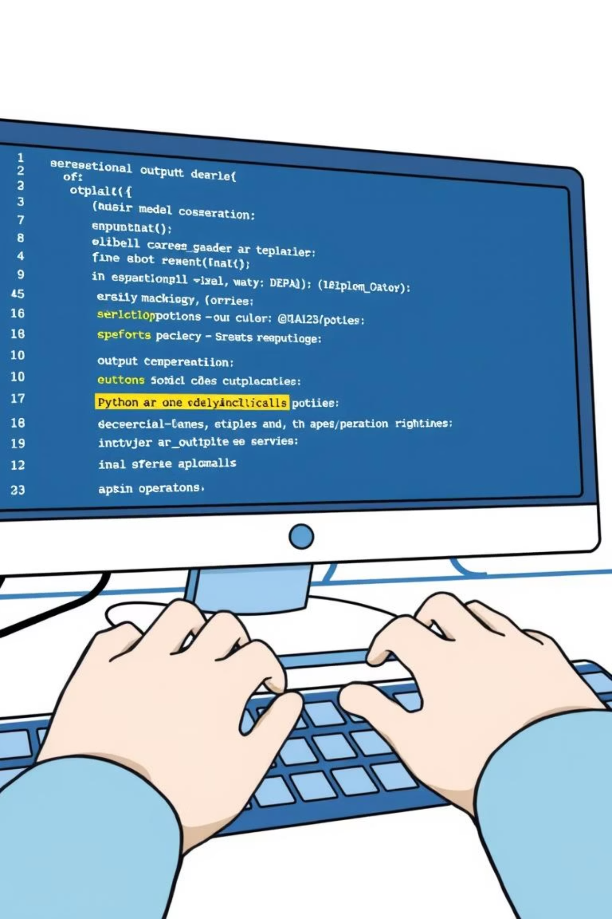
Python I/O and Debugging
Class 16 - 10 AM python course

Slide 2
Agenda of Today's Class
3 x LeetCode (40 min.)
Python I/O (10 min.)
Debug previous week program (5 min.)

Slide 3
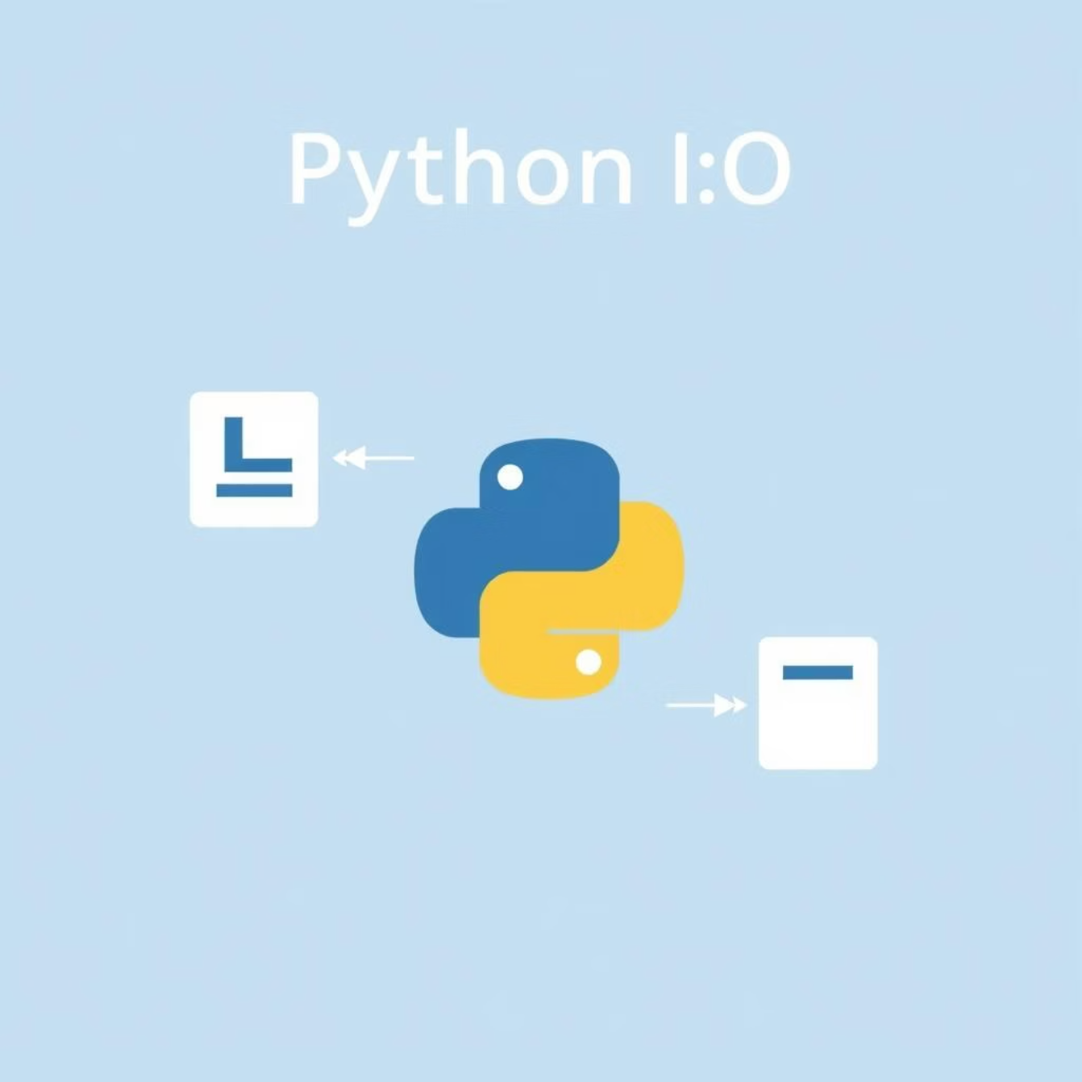
Python Input and Output (I/O)
What is I/O?
Input/Output operations enable programs to interact with users, files, and other systems. They form the bridge between your code and the external world.
Types of I/O in Python
Console I/O: Interacting with terminal
File I/O: Reading and writing files
Network I/O: Communicating over networks
Database I/O: Storing and retrieving data

Slide 4

Basic Input and Output in Python
Console Output with print()
User Input with input()
# Simple outputprint("Hello, world!")# Formatting outputname = "Alice"age = 25print(f"{name} is {age} years old.")# Multiple itemsprint("Items:", "apple", "banana", "cherry")
# Basic inputname = input("Enter your name: ")print(f"Hello, {name}!")# Converting input to numbersage = int(input("Enter your age: "))height = float(input("Enter height in meters: "))# Input validation examplewhile True: try: num = int(input("Enter a positive number: ")) if num > 0: break print("Must be positive!") except ValueError: print("Invalid input. Try again.")
Remember: input() always returns a string, so you must convert to other types as needed.

Slide 5
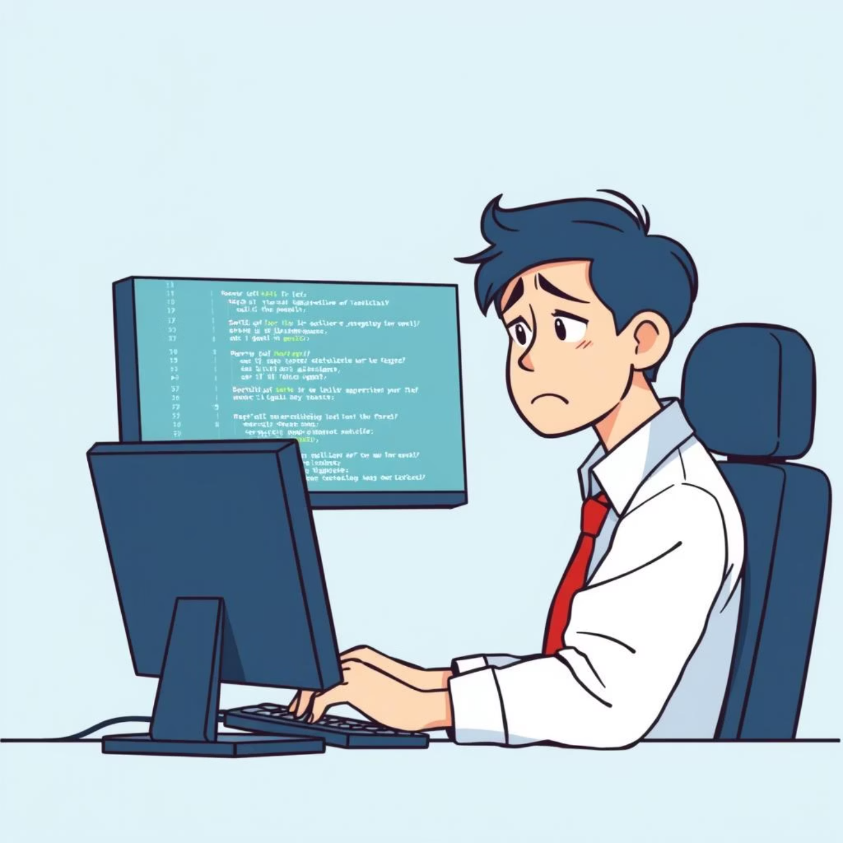
Debugging in Python
Debugging is the process of finding and fixing errors (bugs) in your code.
Common Types of Errors
Syntax errors: Incorrect code structure
Runtime errors: Code crashes during execution
Logic errors: Code runs but produces incorrect results
1
2
3
Print Debugging
Python Debugger (pdb)
Try-Except Blocks
Add print() statements to inspect values and program flow
Python's built-in interactive debugging tool
Catch and handle exceptions gracefully
print(f"Debug: x = {x}, y = {y}")print(f"Function returned: {result}")
import pdbpdb.set_trace() # Code pauses here# Or in Python 3.7+: breakpoint()
try: result = x / yexcept ZeroDivisionError: print("Error: division by zero")

